Slide 1
Code mentor-Ai
Project Presentation Submitted
By:
Tanmay Kumar
Course: B-Tech Cse ( AI-ML )
Batch - 3
Github Link - https://github.com/tanmaykumar7106-collab/CodeMentor-AI

Slide 2
Introduction
CodeMentor AI is a smart learning platform that assists users in understanding code, solving programming problems, and creating software test cases through AI assistance.
It combines a simple and interactive interface with AI models to provide instant feedback, helping users write cleaner code and improve their problem-solving skills.
The project is designed to reduce manual effort in code review and testing while making programming practice more effective for students and aspiring developers.

Slide 3
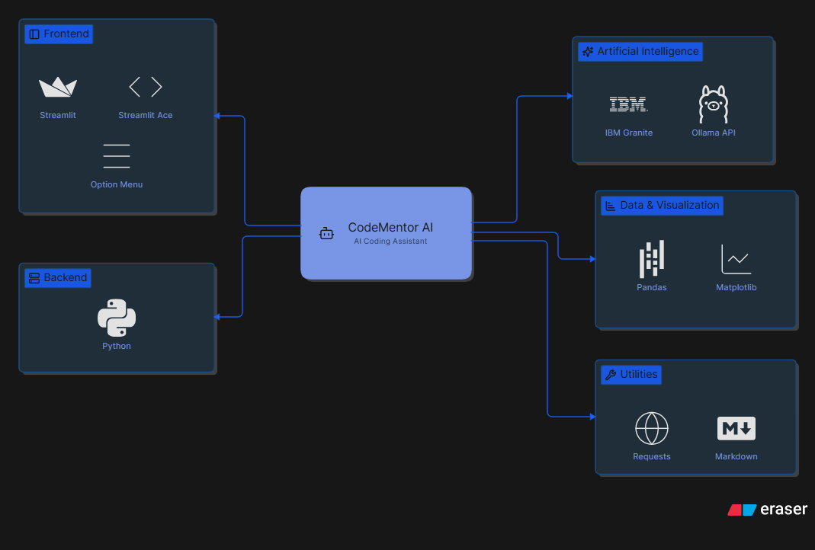
Tech stack

Slide 4
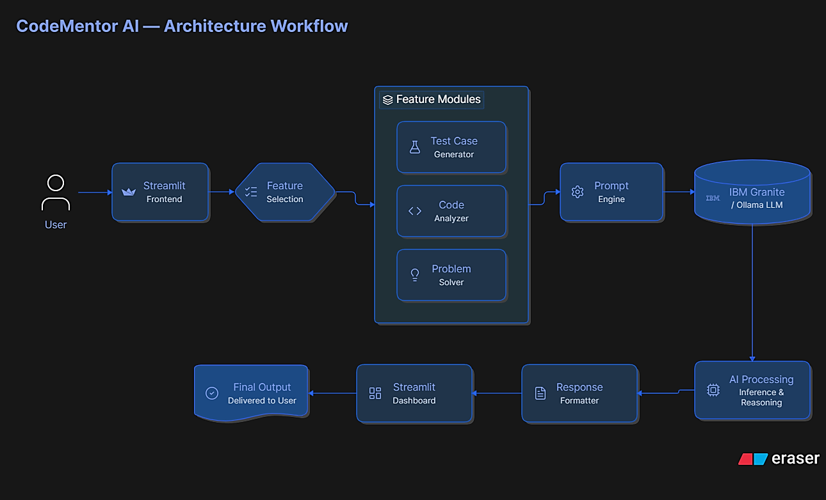

Slide 5
Future Improvements
Multi-Language Support: Extend support for additional programming languages such as C, C++, Java, JavaScript, and Go with language-specific analysis.
User Authentication & History: Implement secure login, cloud storage, and maintain a history of previous analyses and generated reports.
Advanced AI Models: Integrate multiple LLMs and enable users to choose the most suitable model based on accuracy, speed, or specific coding tasks.
Performance & Security Analysis: Add code quality scoring, performance optimization suggestions, vulnerability detection, and best-practice recommendations.
Cloud Deployment & Collaboration: Deploy the platform on the cloud with real-time collaboration, report sharing, and team-based project management features.

Slide 6
References
IBM Granite Documentation – AI model integration and prompt engineering.
Ollama Documentation – Local and cloud LLM setup and API usage.
Streamlit Documentation – Frontend development and interactive dashboard.
Python Official Documentation – Core programming and application development.
Pandas & Matplotlib Documentation – Data processing and visualization. GitHub
Documentation – Version control and project management.

